Slide 1
Threads Session 3
Course : COMP6153
Effective Period : September 2018

Slide 2
Sub Topics
Thread Basics
Thread Model
Benefit of threads
Thread Implementation
Thread Programming

Slide 3
These slides have been adapted from: Stallings, W. (2011). Operating Systems: Internals and Design Principles. 8^{th.} ISBN: 978-0-13-380591-8 Chapter 4
Acknowledgement

Slide 4
Learning Objectives
At the end of this lecture, students are able to:
LO2 : Relate the fundamental design of Threads to the current development of Operating System
LO3 : Demonstrate different Threads implementation
LO4 : Able to write program using threads

Slide 5
Threads (1)
- Threads allow multiple executions to take place in the same process environment
- Lightweight process ⇒ because threads have some properties of processes
- Multithreading ⇒ allowing multiple threads in the same process

Slide 6
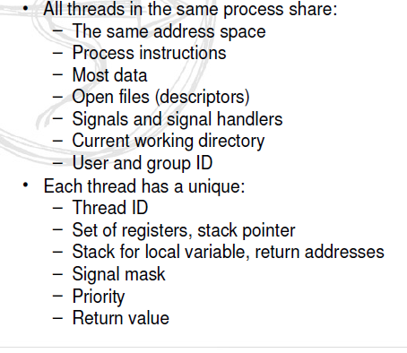
Thread Basics

Slide 7
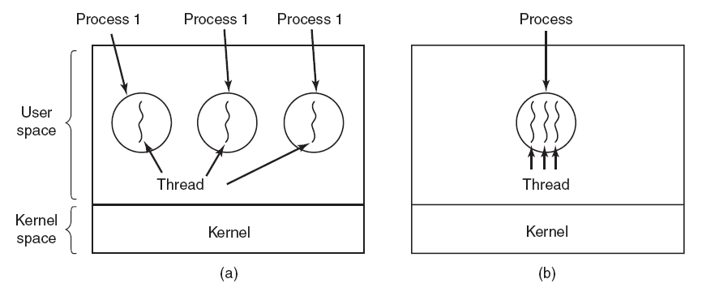
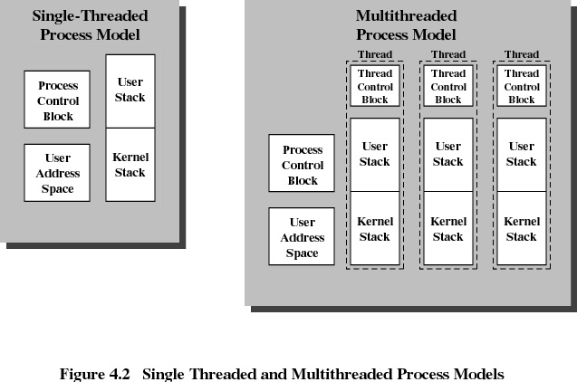
Thread Model (1)

Slide 8
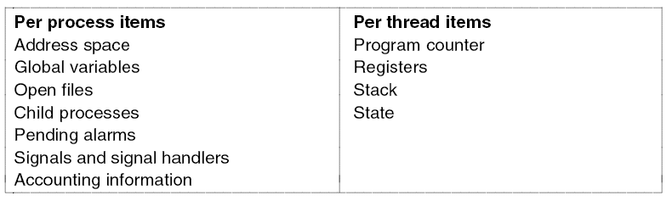
Thread Model (2)
The first column lists some items shared by all threads in a process. The second one lists some items private to each thread.

Slide 9
Benefit of Threads
Takes less time to create a new thread than a process
Less time to terminate a thread than a process
Less time to switch between two threads within the same process
Since threads within the same process share memory and files, they can communicate with each other without invoking the kernel

Slide 10
Thread Synchronization
It is necessary to synchronize the activities of the various threads
all threads of a process share the same address space and other resources
any alteration of a resource by one thread affects the other threads in the same process

Slide 11
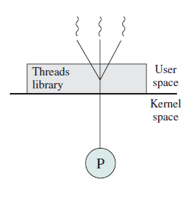
Thread Implementation
User Space
Αdvantages:
Allow each process to have its own scheduling algorithm
Performance
Disadvantages:
ü Implementation of blocking system calls
ü No other threads can run unless the first thread voluntarily gives up the CPU

Slide 12
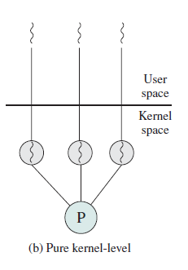
Thread Implementation (2)
Kernel Space
Αdvantages:
Does not need a new non-blocking system calls
Disadvantages:
ü Greater cost of creating and destroying threads

Slide 13
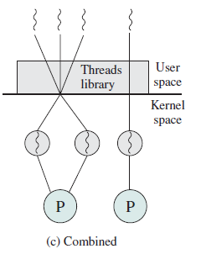
Thread Implementation (3)
Combined
Multiplexing user-level threads onto kernel- level threads

Slide 14
Thread State (1)
Spawn:
Typically, when a new process is spawned, a thread for that process is also spawned.
a thread within a process may spawn another thread within the same process, providing an instruction pointer and arguments for the new thread. The new thread is provided with its own register context and stack space and placed on the ready queue.

Slide 15
Thread State (2)
• Block:
When a thread needs to wait for an event, it will block (saving its user registers, program counter, and stack pointers).
The processor may now turn to the execution of another ready thread in the same or a different process.
• Unblock:
When the event for which a thread is blocked occurs, the thread iscmoved to the Ready queue.
• Finish:
When a thread completes, its register context and stacks are deallocated.

Slide 16
Relationship between Threads and Processes
Threads:Process
Description
Example Systems
1:1
Each thread of execution is a
unique process with its own
address space and resources.
Traditional UNIX implementations
M:1
A process defines an address
space and dynamic resource
ownership. Multiple threads
may be created and executed
within that process.
Windows NT, Solaris, OS/2,
OS/390, MACH

Slide 17
Relationship between Threads and Processes
Threads:Process
Description
Example Systems
1:M
A thread may migrate from one
process environment to
another. This allows a thread
to be easily moved among
distinct systems.
Ra (Clouds), Emerald
M:M
Combines attributes of M:1
and 1:M cases
TRIX

Slide 18
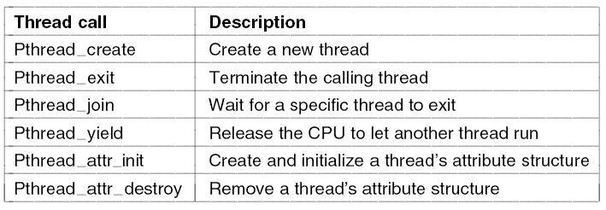
Posix (Portable Operating System Interface) Threads

Slide 19
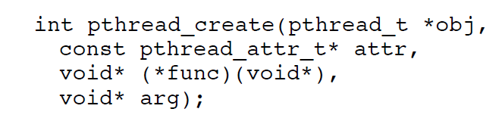
Thread Programming (1)
The obj parameter points to a structure of pthread_t, used to hold the id of the created thread long with the details
Attr parameter points to an object of pthread_attr_t which is used to set special properties of the thread e.g. Scheduling and priority)
If attr is NULL, the thread will becreated with default scheduling and priority properties
func is a pointer to a function.(the function can only take void* parameter)
Arg is a void* which represents thearguments passed to the function func when the thread executed
On success the fuction returns 0

Slide 20
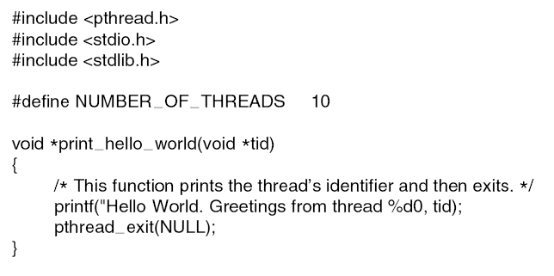
Thread Programming (2)

Slide 21
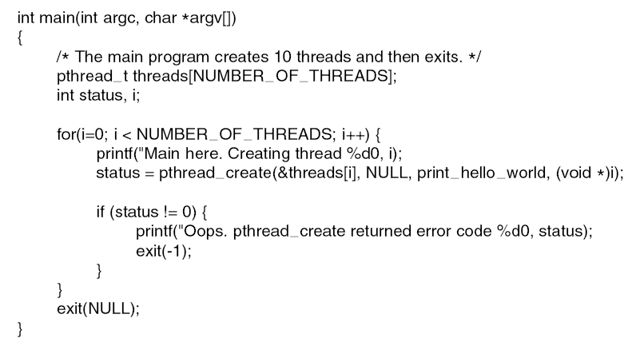
Thread Programming (3)

Slide 22
Thread programming (4)
pthread_self()
To obain its ID
pthread_join()
To join or rejoin various flows of control
Wen called, the calling thread is suspended untl the execution of the target thread is termnated
Releases resources (i.e. prevents zombie threads)

Slide 23
Thread programming (5)
Example:
#include <iostream>
#include <pthread.h>
using namespace std;
int main(int argc, char** argv)
{
pthread_t thread_a, thread_b;
int N;
if (argc != 2)
{
cout << “Error” << endl;
return 0;
}
N=atoi(argv[1]);
pthread_create(&thread_a, NULL, task1, &N);
pthread_create(&thread_b, NULL, task2, &N);
cout << “Waiting to join” << endl;
pthread_join(thread_a, NULL);
pthread_join(thread_b, NULL);
return 0;
}

Slide 24
Thread programming (6)
Sample function for task
void* task1(void* x)
{
int* temp = (int*) x;
for (int count 0; count < *temp;
count++)
{
cout << “Thread A” << endl;
}
cout << “Thread A Complete” << endl;
return NULL;
}

Slide 25
Java Thread
Define a class that implements Runnable interface
When a class implementsRunnable, it must define a run() method.
The code implementing the run() method is what runs as a separate thread

Slide 26
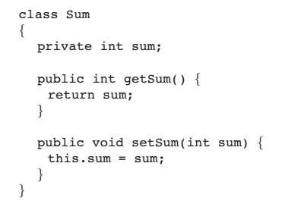
Java Thread Example
multithreaded program that determines the summation of a non-negative integer
Source: Operating Systems Concepts with Java, Silberschatz, Galvin and Gagne

Slide 27
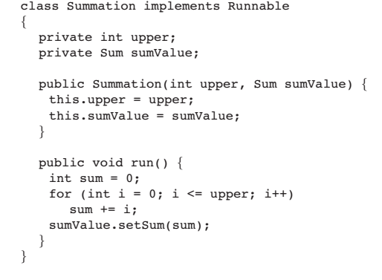
Java Thread Example
Source: Operating Systems Concepts with Java, Silberschatz , Galvin and Gagne

Slide 28
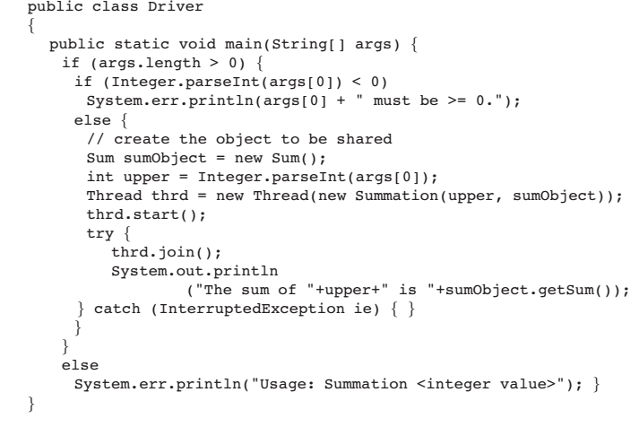
Java Thread Example
Source: Operating Systems Concepts with Java, Silberschatz, Galvin and Gagne

Slide 29
References
Stallings, W. (2014). Operating Systems: Internals and Design Principles. 8^{th.} ISBN: 978-0-13-380591-8
www.yolinux.com
Abraham Silberschatz, Peter B. Galvin, Greg Gagne (2010). Operating System Concepts 8th ed. With Java
ISBN: 978-0-470-50949-4

